Slide 1
Embeddes Systems
Digital Input & Output

Slide 2
Week overview
Digital I/O
Ports (initialization)
Led & Button
Programming
Flowchart
Variables
if ... else ...

Slide 3
Ports on the Leonardo
Arduino has 20 ports. GPIO (general purpose input output)
All ports can be configured as Digital Input & Output
Some ports have additional special functions. Analog/PWM/Interrupt/serial comm
Devices can be connected to ports.
Today: Leds and Buttons

Slide 4
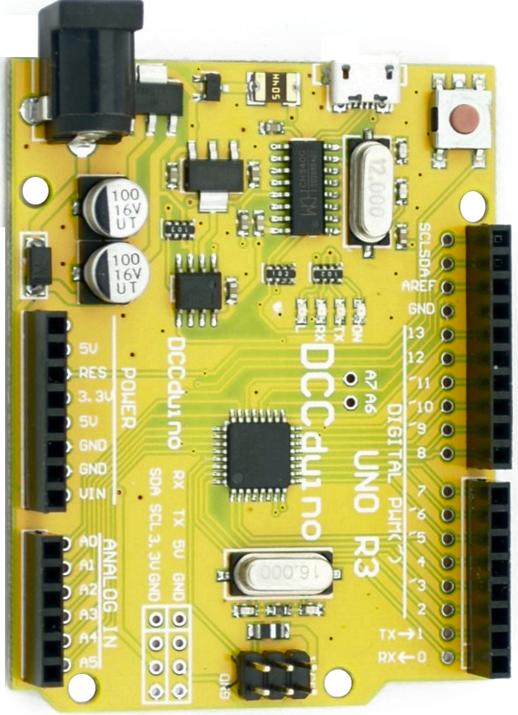
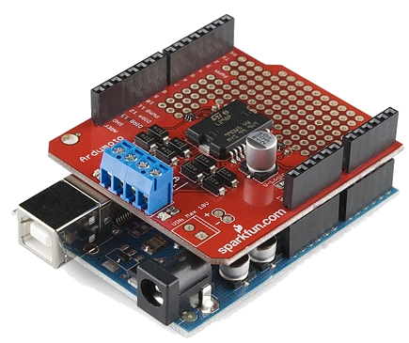
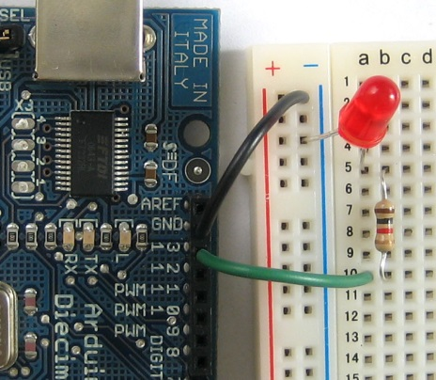
Arduino I/O
actuators
sensors
14 digital output (of which 6 PWM)
14 digital input
6 analog input
breadboard
RGB led
temp sensor
…
shield
Zigbee
GPS logger
RFID
display
touchscreens
…
Notes:
example of what Arduino can do.

Slide 5
What is digital I/O?
Digital I/O is a signal that is either HIGH or LOW.
In many digital systems (Computers, Embedded Controllers)
High is 5V or 3.3V
Low is 0V or GND
If an output is HIGH a led might be lit up.
If an input is LOW a button might be pressed etc.

Slide 6
Port Usage
Ports should be initialized as INPUT or OUTPUT
Output: Set with:
pinMode(13, OUTPUT); // Set built-in led as output
Ports can then be set HIGH or LOW (= On or Off)
digitalWrite(13, HIGH);

Slide 7
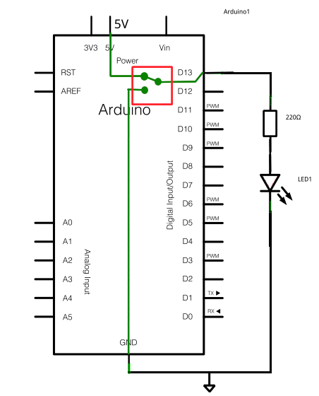
Digital output
Port D13 configured as output acts like a switch between HIGH(5v) and (LOW)ground.
when the switch is up (HIGH) 5 volt is applied to the LED
when the switch is down (LOW) no current flows.
Notes:
bridge to LED

Slide 8
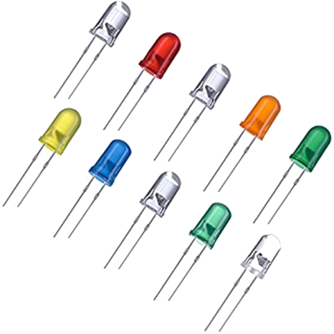


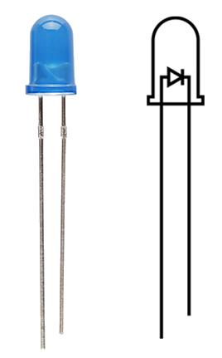
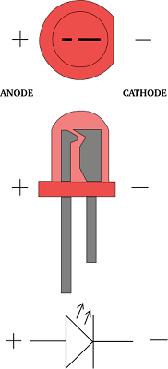
LED (Light Emitting Diode)
converts energy into light
diode = one way street for current
correct direction = no resistance (or 0Ω)
wrong direction = high resistance
Find positive/negative side of a LED
long lead: +
short lead: -
flat side: -

Slide 9
Code structure (example blink program)
// the setup function runs once when you press reset or power the board
void setup() {
// initialize digital pin LED_BUILTIN as an output.
pinMode(LED_BUILTIN, OUTPUT);
}
/* the loop function runs over and over again forever */
void loop() {
digitalWrite(LED_BUILTIN, HIGH); // turn the LED on (HIGH is the voltage level)
delay(1000); // wait for a second
digitalWrite(LED_BUILTIN, LOW); // turn the LED off by making the voltage LOW
delay(1000); // wait for a second
}
Notes:
Discuss the program. The way it runs (setup and loop). Line by line. semicolon at end of statement. Comments. Setting pinmode & writing HIGH and Low. Delay to sleep

Slide 10
Port usage INPUT
Set with:
pinMode(8, INPUT_PULLUP); // set button1 as input
Read with:
int button1 = digitalRead(8);

Slide 11
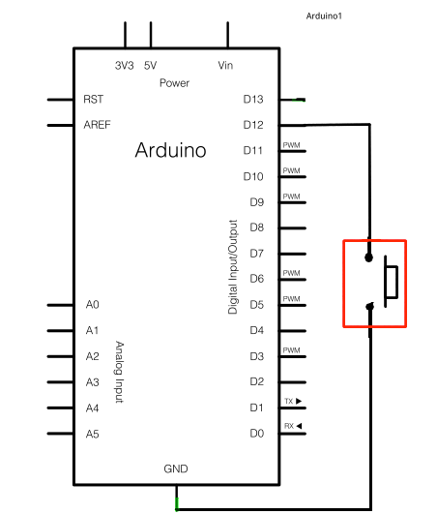
Digital input
Port D12 is configured as INPUT

Slide 12
Build a program.
Design
program
Switch on Led when button is pressed
Design/Make flow chart
Write program
Test
Update
Write program
Test
No
Correct?
Yes
Congrats

Slide 13
Design program (make the flow chart)
Read the button
If button pushed
Set led on
Not pushed
Set led off
Repeat
Read button
Button pushed?
Yes
No
Set Led on
Set Led Off

Slide 14
How to code the decision?
int button1;
button1 = digitalRead(8);
if (button1 == HIGH) {
digitalWrite(4, HIGH);
}
else {
digitalWrite(4, LOW);
}
Read button
Button pushed?
Yes
No
Set Led on
Set Led Off

Slide 15
Line by line
int button1; // declare variable button1
button1 = digitalRead(8); // read the button and assign the
result to button1
if (button1 == HIGH) { // was button1 high?
digitalWrite(4, HIGH); // yes, so set the led to on
}
else { // no, it was low
digitalWrite(4, LOW); // so set the led to off
}

Slide 16
Variables
C has variables.
A variable is a box to store a value in.
Most common:
int n; // integer numbers (ℤ)
char s; // letters
float x; // real numbers (ℝ)
Usage:
int x = 10;
int count = 5;
char letter = 'x';
float p = 1.414;

Slide 17
Line by line
int button1; // declare variable button1
button1 = digitalRead(8); // read the button and assign the
result to button1
if (button1 == HIGH) { // was button1 high?
digitalWrite(4, HIGH); // yes, so set the led to on
}
else { // no, it was low
digitalWrite(4, LOW); // so set the led to off
}

Slide 18
Line by line
int button1; // declare variable button1
button1 = digitalRead(8); // read the button and assign the
result to button1
if (button1 == HIGH) { // was button1 high?
digitalWrite(4, HIGH); // yes, so set the led to on
}
else { // no, it was low
digitalWrite(4, LOW); // so set the led to off
}

Slide 19
The IF statement
1: if (/* condition*/) {
2: // only if condition is true
3: // go to line 5
4: }
5: // always continue here.

Slide 20
Line by line
int button1; // declare variable button1
button1 = digitalRead(8); // read the button and assign the
result to button1
if (button1 == HIGH) { // was button1 high?
digitalWrite(4, HIGH); // yes, so set the led to on
}
else { // no, it was low
digitalWrite(4, LOW); // so set the led to off
}

Slide 21
The IF statement
1: if (/* condition*/) {
2: // if condition is true
3: // go to line 9
4: }
5: else {
6: // do something if condition is NOT true
7: // go to line 9
8: }
9: // always continue here.

Slide 22
The condition
The condition can be any boolean expression. I.e. anything that evaluates to true or false.
a == b
6 < 1
x >= 5
Operator | Description
== | Equals to
!= | Not equals to
> | Greater than
< | Less than
>= | Greater than or equal
<= | Less than or equal
Notes:
explain truth tables here

Slide 23
Did the button work correctly?

Slide 24
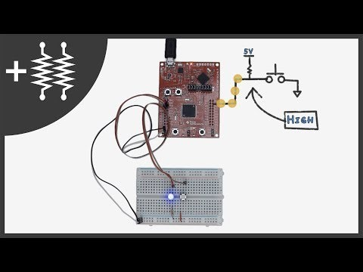
Pull up resistor

Slide 25
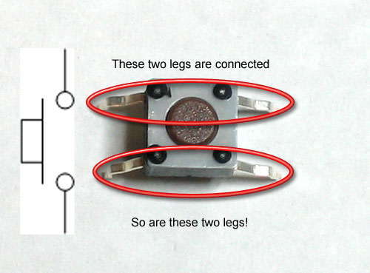
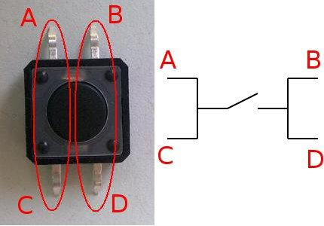
Buttons

Slide 26
Resources
https://youtu.be/wxjerCHCEMg
https://www.arduino.cc/reference/en/language/variables/constants/constants/
https://www.arduino.cc/en/tutorial/button

